Slide 1
Critical Values
The ‘2’ in (our 95% confidence interval) came from the 68-95-99.7% Rule.
Using a table or technology, we find that a more exact value for our 95% confidence interval is 1.96 instead of 2.
We call 1.96 the critical value and denote it z*.
For any confidence level, we can find the corresponding critical value (the number of SEs that corresponds to our confidence interval level).

Slide 2
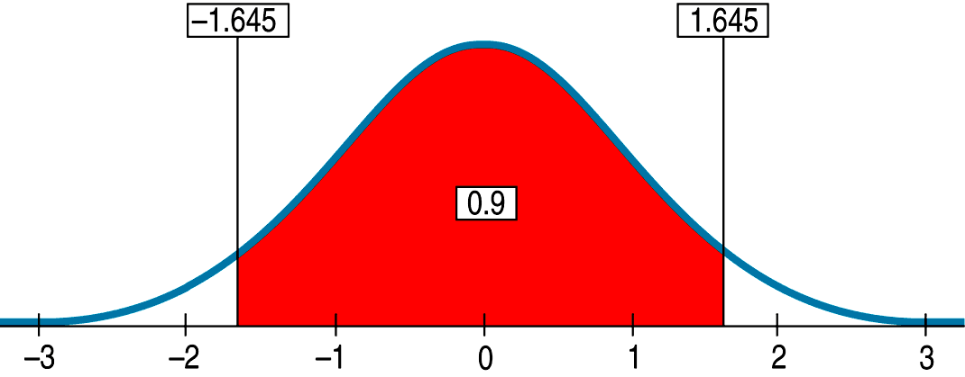
Critical Values (cont.)
Example: For a 90% confidence interval, the critical value is 1.645:

Slide 3
Assumptions and Conditions
All statistical models make upon assumptions.
Different models make different assumptions.
If those assumptions are not true, the model might be inappropriate and our conclusions based on it may be wrong.
You can never be sure that an assumption is true, but you can often decide whether an assumption is plausible by checking a related condition.

Slide 4
Assumptions and Conditions (cont.)
Here are the assumptions and the corresponding conditions you must check before creating a confidence interval for a proportion:
Independence Assumption: We first need to Think about whether the Independence Assumption is plausible. It’s not one you can check by looking at the data. Instead, we check two conditions to decide whether independence is reasonable.

Slide 5
Assumptions and Conditions (cont.)
Randomization Condition: Were the data sampled at random or generated from a properly randomized experiment? Proper randomization can help ensure independence.
10% Condition: Is the sample size no more than 10% of the population?
Sample Size Assumption: The sample needs to be large enough for us to be able to use the CLT.
Success/Failure Condition: We must expect at least 10 “successes” and at least 10 “failures.”

Slide 6

One-Proportion z-Interval
When the conditions are met, we are ready to find the confidence interval for the population proportion, p.
The confidence interval is
where
The critical value, z*, depends on the particular confidence level, C, that you specify.

Slide 7
Choosing Your Sample Size
The question of how large a sample to take is an important step in planning any study.
Choose a Margin or Error (ME) and a Confidence Interval Level.
The formula requires which we don’t have yet because we have not taken the sample. A good estimate for , which will yield the largest value for (and therefore for n) is 0.50.
Solve the formula for n.

Slide 8
What Can Go Wrong?
Don’t Misstate What the Interval Means:
Don’t suggest that the parameter varies.
Don’t claim that other samples will agree with yours.
Don’t be certain about the parameter.
Don’t forget: It’s about the parameter (not the statistic).
Don’t claim to know too much.
Do take responsibility (for the uncertainty).
Do treat the whole interval equally.

Slide 9
What Can Go Wrong? (cont.)
Margin of Error Too Large to Be Useful:
We can’t be exact, but how precise do we need to be?
One way to make the margin of error smaller is to reduce your level of confidence. (That may not be a useful solution.)
You need to think about your margin of error when you design your study.
To get a narrower interval without giving up confidence, you need to have less variability.
You can do this with a larger sample…

Slide 10
What Can Go Wrong? (cont.)
Choosing Your Sample Size:
In general, the sample size needed to produce a confidence interval with a given margin of error at a given confidence level is:
where z* is the critical value for your confidence level.
To be safe, round up the sample size you obtain.

Slide 11
What Can Go Wrong? (cont.)
Violations of Assumptions:
Watch out for biased samples—keep in mind what you learned in Chapter 12.
Think about independence.

Slide 12
What have we learned?
Finally we have learned to use a sample to say something about the world at large.
This process (statistical inference) is based on our understanding of sampling models, and will be our focus for the rest of the book.
In this chapter we learned how to construct a confidence interval for a population proportion.
Best estimate of the true population proportion is the one we observed in the sample.

Slide 13
What have we learned?
Best estimate of the true population proportion is the one we observed in the sample.
Create our interval with a margin of error.
Provides us with a level of confidence.
Higher level of confidence, wider our interval.
Larger sample size, narrower our interval.
Calculate sample size for desired degree of precision and level of confidence.
Check assumptions and condition.

Slide 14
What have we learned?
We’ve learned to interpret a confidence interval by Telling what we believe is true in the entire population from which we took our random sample. Of course, we can’t be certain, but we can be confident.

